Slide 1
More About Authentication

Slide 2
Today’s Content
Handle duplicate registration
@Bean
Reference: https://www.baeldung.com/registration-with-spring-mvc-and-spring-security
https://www.javadevjournal.com/spring-security/registration-with-spring-security/

Slide 3
Check duplicated registration
@PostMapping("/process_register")
public String processRegister(User user, Model model) {
BCryptPasswordEncoder passwordEncoder = new BCryptPasswordEncoder();
String encodedPassword = passwordEncoder.encode(user.getPassword());
user.setPassword(encodedPassword);
User u = userRepo.findByEmail(user.getEmail());
if (u !=null) {
//sent an error message
Map<String, Object> map = new HashMap<>();
map.put("message", "Email already existed existed");
model.addAllAttributes(map);
return "signup_form";
} else {
userRepo.save(user);
return "register_success";
}
}
Notes:
Change

Slide 4
Add message to the .html
<div>
<p th:text="${message}"></p>
</div>

Slide 5
Compare the difference
return "signup_form";
return “redirect:/register";
Notes:
url remain not changed with return.
Redirect:---get http request, variables are passed through url
return "register_success"; can be challenged to return "redirect:/login"; the login page is provided by spring security

Slide 6
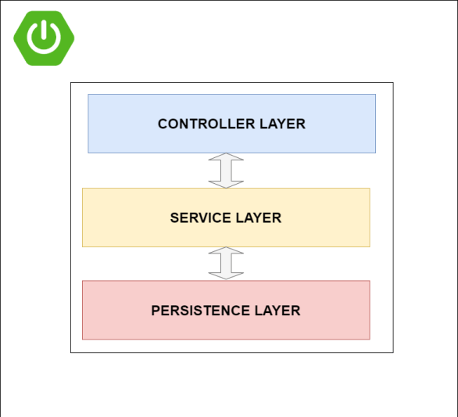
A better solution with a service layer
Notes:
Controller-connect to the database through repository---security issue
Change in repository will cause change in controller. Ideally, change one will not need to change the other. For example, findByEmail->findByName
https://programmingtechie.com/2020/10/16/spring-boot-testing-tutorial-unit-testing-with-junit-5-and-mockito/

Slide 7
Create a “UserService” Interface in the service package
public interface UserService {
public void saveUser (User user) throws UserAlreadyExistException;
// public boolean isUserAlreadyPresent(User user);
}

Slide 8
Create a “UserServiceImp” class
@Service
public class UserServiceImp implements UserService {
@Autowired
private UserRepository userRepo;
@Override
public void saveUser(User user) throws UserAlreadyExistException {
if (emailExists(user.getEmail())) {
throw new UserAlreadyExistException("There is an account with that email address: "
+ user.getEmail());
}
    BCryptPasswordEncoder passwordEncoder = new BCryptPasswordEncoder();
    String encodedPassword = passwordEncoder.encode(user.getPassword());
    user.setPassword(encodedPassword);
userRepo.save(user);
}
private boolean emailExists(String email) {
return userRepo.findByEmail(email) != null;
}
}

Slide 9
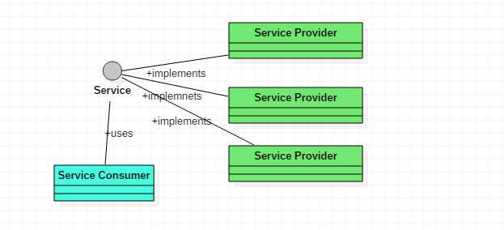
Why interface?
There are multiple implementations for a service and they are called as service providers.
The client using this service will not have any contact with the implementations.
The consumer which is client knows only about the service interface.
The service loader will instantiate all the service providers that are implementing the service and makes it available to the consumer to use.
https://www.codingame.com/playgrounds/3549/java-9-service-implementation
More information can be found here https://softwareengineering.stackexchange.com/questions/159813/do-i-need-to-use-an-interface-when-only-one-class-will-ever-implement-it
Notes:
The interface is not absolutely necessary. It would have worked exactly the same without the interface. But the point of having the interface is to separate the implementation so that you have less coupling, and it makes it easier to, for example, inject a mock implementation of the service for unit testing. In unit testing, another implementation will be made to the interface.---Polymorphism
Good practice of Object-oriented programming
https://stackoverflow.com/questions/37541168/code-architecture-of-service-interface-and-service-impl-classes-spring

Slide 10
Add the UserAlreadyExistExeption class in a “exception” package
public class UserAlreadyExistException extends Exception {
public UserAlreadyExistException() {
super();
}
public UserAlreadyExistException(String message) {
super(message);
}
public UserAlreadyExistException(String message, Throwable cause) {
super(message, cause);
}
}

Slide 11
Update “App Controller”
@Autowired
UserService userService;
@PostMapping("/process_register")
public ModelAndView processRegister(User user, Model model){
try {
userService.saveUser(user);
return new ModelAndView ("redirect:/login");
}catch (UserAlreadyExistException e) {
model.addAttribute("message", "An account already exists for this email");
return new ModelAndView("signup_form");
}
}

Slide 12
ModelAndView
This class make it possible for a controller to return both model and view in a single return value.
https://docs.spring.io/spring-framework/docs/current/javadoc-api/org/springframework/web/servlet/ModelAndView.html

Slide 13
Some benefit of using a Service layer
Repository/DAO only handle CRUD with database, service layer handle business logic.
Provides Security--If you provide a service layer that has no relation to the database, then is it more difficult to gain access to the database from the client except through the service.—More secure!
Loose coupling
Difference between Repository and DAO https://www.baeldung.com/java-dao-vs-repository
https://medium.com/stackavenue/why-to-use-service-layer-in-spring-mvc-5f4fc52643c0
Notes:
Create, read, update and delete
If there is any change to database. No need to update the controller layer.

Slide 14
The passwordEncoder object is useless after encoding the password
Ideally, we do not need to create the object to use the encode function
BCryptPasswordEncoder passwordEncoder = new BCryptPasswordEncoder();
String encodedPassword = passwordEncoder.encode(user.getPassword());
user.setPassword(encodedPassword);

Slide 15
What is @Beans?
In Spring, the objects that form the backbone of your application and that are managed by the Spring IoC container are called beans. A bean is an object that is instantiated, assembled, and otherwise managed by a Spring IoC container.
https://www.baeldung.com/spring-bean

Slide 16
An example
public class Address {
private String street;
private int number;
  public Address(String street, int number) {
  this.street = street;
  this.number = number;
  }
  // getters and setters
}
public class Company {
private Address address;
  public Company(Address address) {
  this.address = address;
  }
// getter, setter and other properties
}

Slide 17
Traditional Approach of creating a company object
Address address = new Address("High Street", 1000);
Company company = new Company(address);
The address object is actually not necessary----we only need the address, but to get it, an address object is created
Notes:
The address object is actually not necessary----we only need the address, but to get it, an address object is created

Slide 18
Inversion of Control (IoC)
Instead of constructing dependencies by itself, an object can retrieve its dependencies from an IoC container.
All we need to do is to provide the container with appropriate configuration metadata.
@Configuration @ComponentScan(basePackageClasses = Company.class)
public class Config {
  @Bean
  public Address getAddress() {
  return new Address("High Street", 1000);
  }
}
public class Company {
private Address address;
  public Company(Address address) {
  this.address = address;
  }
// getter, setter and other properties
}

Slide 19
Inversion of Control (IoC)
Inversion of Control (IoC) is a process in which an object defines its dependencies without creating them. This object delegates the job of constructing such dependencies to an IoC container.
Notes:
https://www.baeldung.com/spring-bean

